Slide 1
3D Gesture Vocabulary
George Mudrak
CS 525 Multimedia Communications & Computing
Dr. Chow
May 5th 2010

Slide 2
Overview
Definition
Why think about this
Input today
Input tomorrow
Core Gestures
Applications and Possibilities

Slide 3
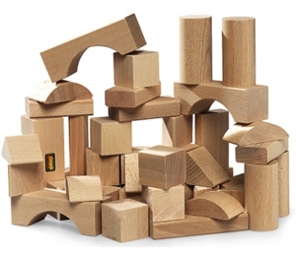
Definition
vo· cab· u· lary
A list or collection of words or of words and phrases usually alphabetically arranged and explained.
(a) A sum or stock of words employed by a language, group, individual, or work or in a field of knowledge. (b) a list or collection of terms or codes available for use.
A supply of expressive techniques or devices
I focused on…..
(b) a list or collection of terms or codes available for use.
A supply of expressive techniques or devices

Slide 4
Why Think About This
Benefits
Greater interactivity
People interact in 3D
Intuitive
Natural
Greater productivity
Implicit knowledge transfer
Greater interactivity
Foundational
Keyboard and mouse
Need a “vocabulary” of core gestures.

Slide 5
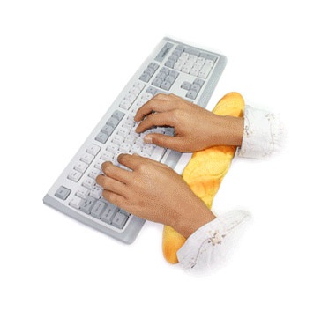
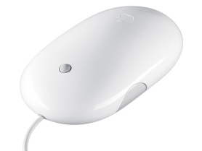
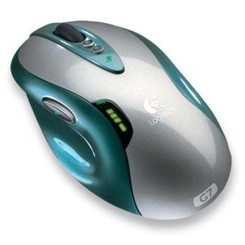
Input today
Keyboard
Vocabulary based on natural language, alphabet letters
Mouse
Vocabulary based on buttons
Planer
Restricted to 2 dimensions and flat information processing

Slide 6
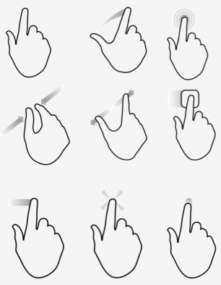
Input tomorrow
Gestures
Hand gestures
Increase affordances (possible functions)
Multi-Planer
Increase directions via depth
Cross domain knowledge transfer

Slide 7
Gestures
Mouse - Neutral | Gesture
Left click | Select
Drag selection | Pinch
Drag | Move w/pinch
Drop | Open Pinch
Gestures*
Select – 1 or 2 fingers to “pick” an object by “touching” it.
Pinch – utilizing 2 or 3 fingers to “pick up” an object.
Move w/pinch – while maintaining the pinch gesture, move your hand to a new X, Y location.
Drop – “release” the pinch hand position.
*More in the research paper.

Slide 8
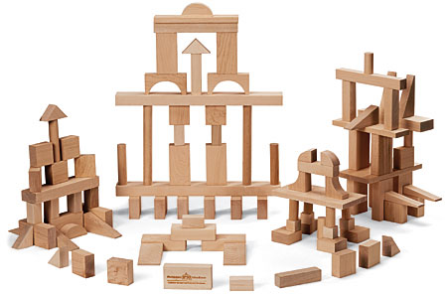
Application Possibilities
Relevancy searches using depth
Remote control of robotic devices
Organic modeling
Computer gaming
Data modeling and manipulation
Therapy
…

Slide 9
References
C. Keskin, A. Erkan, L.Akarun. “Real Time Hand Tracking and 3D Gesture Recognition for Interactive Interfaces Using HMM,”. Paper.
C. Miller, Multi-touch Interaction Input Device, http://10gui.com/.
Wikipedia.Org, “Gesture recognition,” http://en.wikipedia.org/wiki/Gesture_recognition
D. Norman, “Things That Make Us Smart”. Basic Books, © 1993
M. Csikszentmihalyi, “Flow, the psychology of optimal experience”, Haeper Perennial Modern Classics, © 2008

